Slide 1

Rate My Professors – A Statistical Study
Taís, Deidra, Emilia

Slide 2
Introduction
Data:
20,000 reviews with 51 variables
Cleaned to 969 Professors and 32 variables
From:
Website: Dr. Jibo
Notes:
Emilia

Slide 3


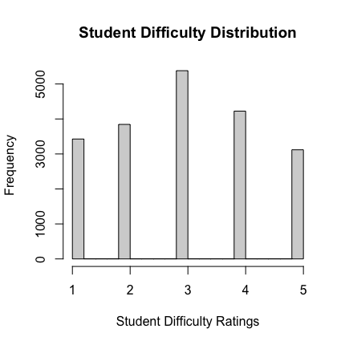
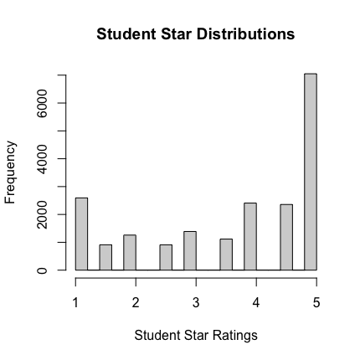
Distributions of Ratings and Difficulty from Students
Notes:
Histogram for star ratings and difficulties -> what does this show us?
Emilia

Slide 4
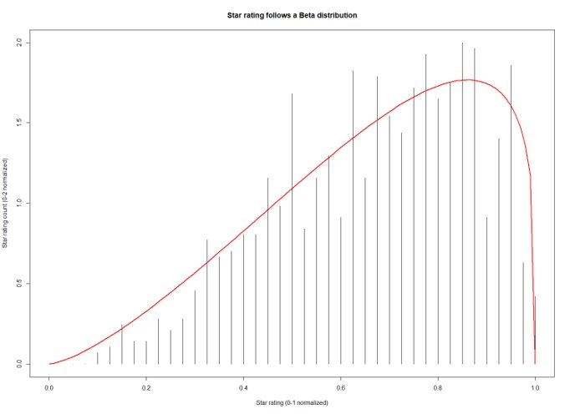
Overall Distribution of Professor's Ratings

Slide 5
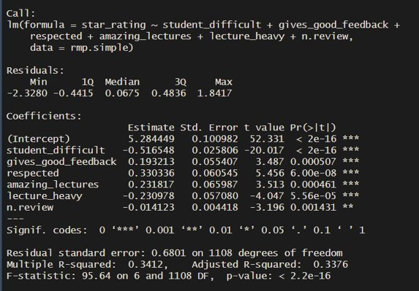
Linear Model

Slide 6

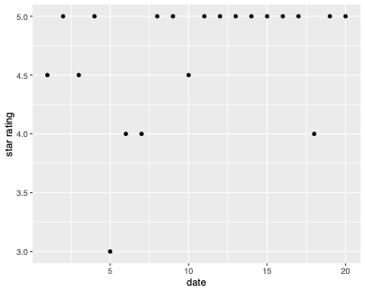

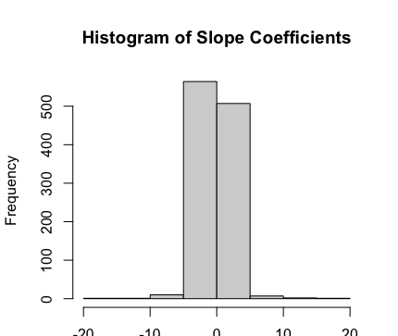
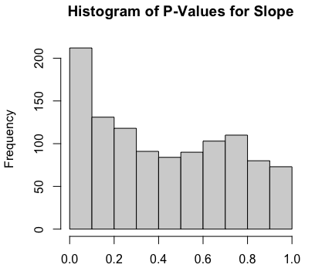
Professor Ratings Overtime
Notes:
Emilia

Slide 7
Correlation with Race and Gender on Professor’s Tags + Means
Correlations: | gender | race
school name | 0.1424 | 0.2147
star rating | -0.0082 | 0.0035
gender | 1 | 0.0368
race | 0.0368 | 1
student difficult | 0.1424 | 0.0377
caring | -0.0464 | -0.1225
respected | -0.0553 | -0.0104
inspirational | 0.009 | -0.142
n review | 0.0307 | -0.0676
n class | -0.0125 | 0.0822
stem | 0.0375 | 0.011
Means: | Females(0) | Males(1)
school name | 0 | 0.1333
star rating | 3.632 | 3.612
race | 0.5357 | 0.5889
student difficult | 3.184 | 3.017
caring | 0.3214 | 0.2611
respected | 0.3571 | 0.2833
inspirational | 0.1786 | 0.1889
n review | 17.07 | 17.41
n class | 5.929 | 5.844
stem | 0.25 | 0.3
Means: | White(1) | Other(0)
school name | 0.1736 | 0.0345
star rating | 3.617 | 3.611
gender | 0.876 | 0.8506
student difficult | 3.065 | 3.005
caring | 0.2231 | 0.2708
respected | 0.2893 | 0.2989
inspirational | 0.1405 | 0.2529
n review | 17.15 | 17.67
n class | 6.017 | 5.632
stem | 0.2975 | 0.2874
White professors are found more in Universities than non-white professors (p-value = 0.0006)
Other races (non-white) have higher Inspirational scores (p-value = 0.0488 )

Slide 8
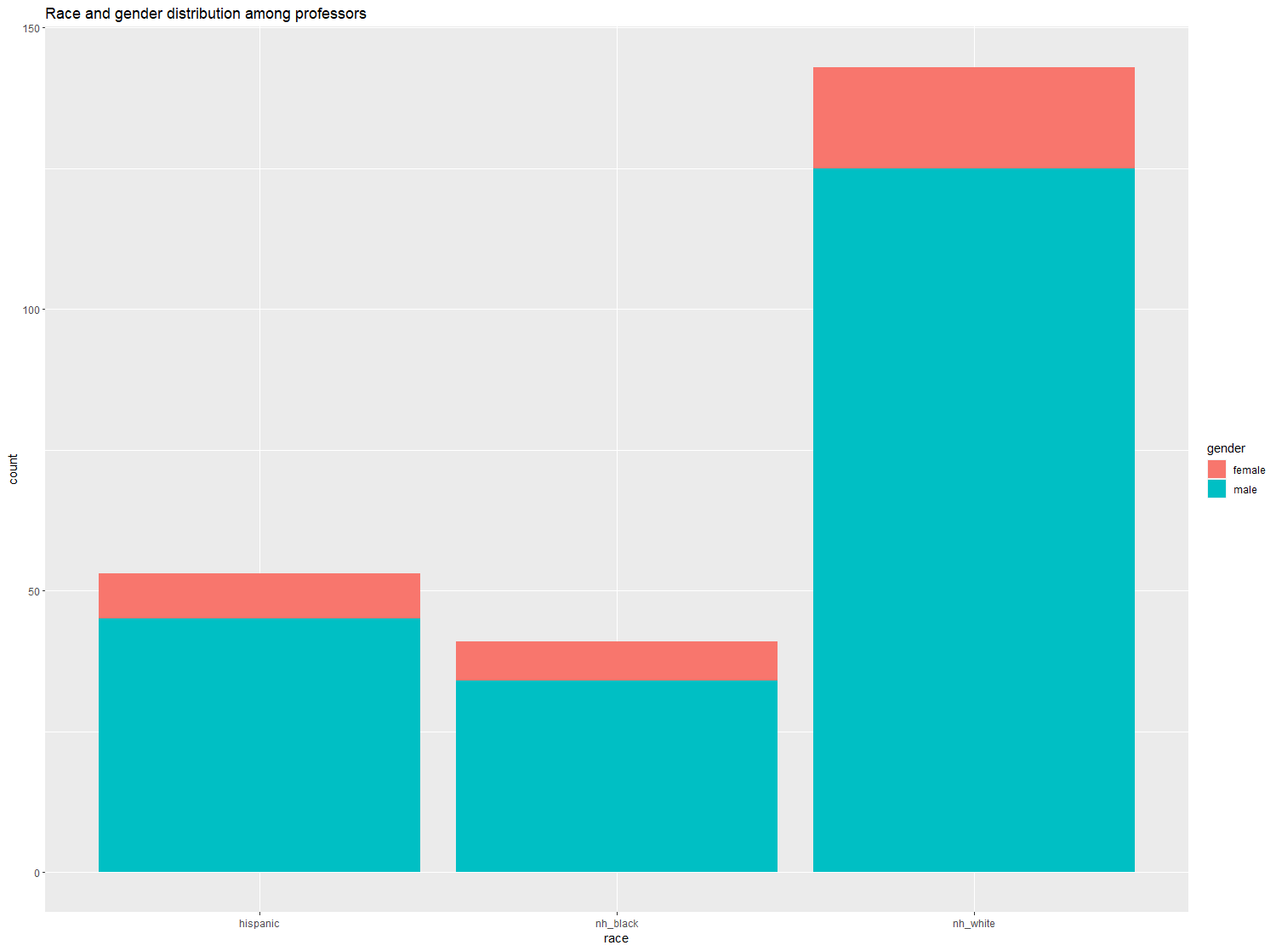
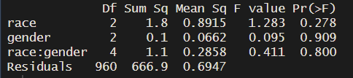
Race and gender

Slide 9

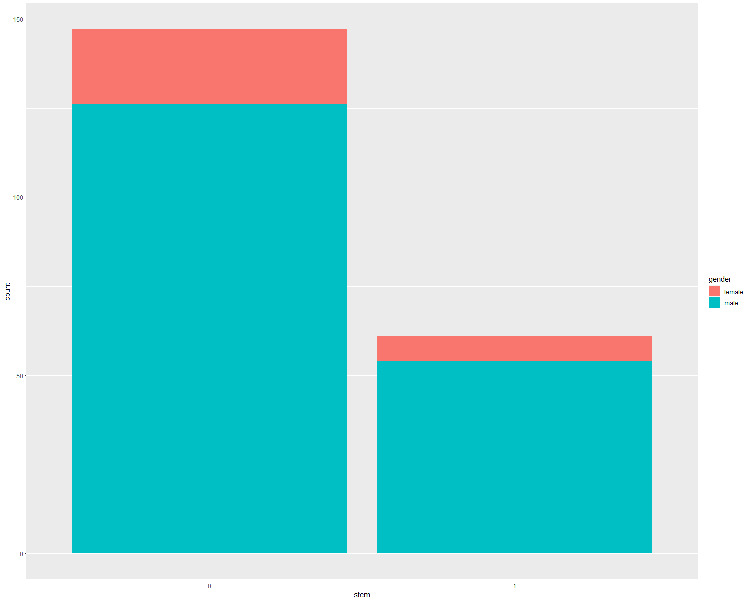
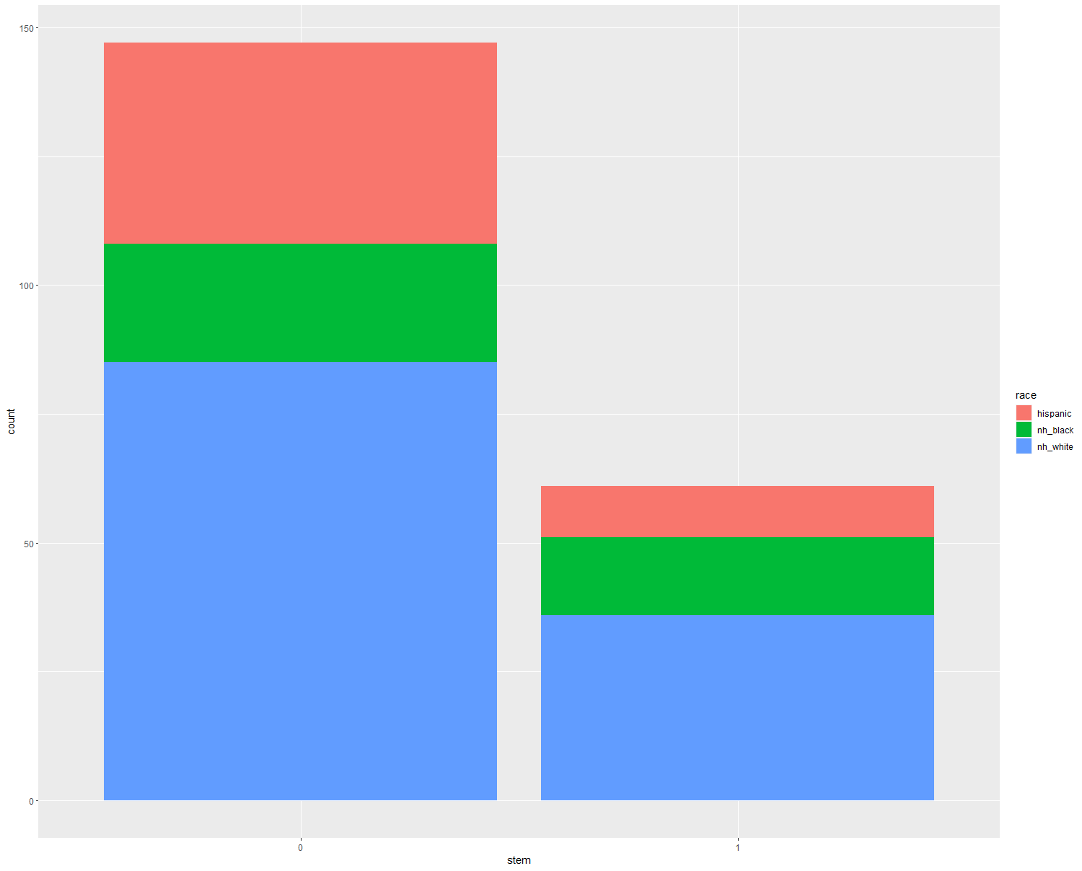
STEM vs non-STEM
95% CI: {-0.28, -0.04}
p-value = 0.007

Slide 10
Means of subject type and school name on tags
Means: | Stem | Non-stem
star rating | 3.467 | 3.676
school name | 0.2623 | 0.05442
gender | 0.8852 | 0.8571
race | 0.5902 | 0.5782
student difficult | 3.095 | 3.017
caring | 0.3115 | 0.2517
respected | 0.3115 | 0.2857
inspirational | 0.2131 | 0.1769
n reviews | 17.56 | 17.29
n class | 5.721 | 5.912
Finding:
T-test on subject type (stem or non-stem)
Respected: p-value = 0.0006
Inspirational: p-value = 0.0488
School name: p-value = 0.0008
T-test on school names
Stem: p-value = 0.0003
Means: | Community(1) | University(0)
inspirational | 0.2917 | 0.1739
star rating | 3.575 | 3.62
gender | 1 | 0.8478
race | 0.875 | 0.5435
student difficult | 2.952 | 3.051
caring | 0.4167 | 0.25
respected | 0.2917 | 0.2935
n review | 18.29 | 17.24
n class | 6.167 | 5.815
stem | 0.6667 | 0.2446

Slide 11
Conclusion
Students use rate my professor when they feel strongly about a professor
The data does not demonstrate the professors are getting better over time
There are much more male professors than female, but the race distribution follows the country's demographic
There is a small but significant difference in the ratings of STEM professors vs non-STEM professors

Slide 12
Next Steps
Use all the data from the website
1
Investigate ratings over time further with better maintenance of "date" information
2
Gather gender for all the professors
3
Test our predictor model
4

